Slide 1
An approximation to e^{x}
MTH 125

Slide 2

Infinite Series for e^{x}
The infinite series for the exponential function is:
$$e^{x}=\sum_{k=0}^{∞}{\frac{x^{k}}{k!}}=1+x+\frac{x^{2}}{2}+\frac{x^{3}}{6}+…+\frac{x^{n}}{n!}+…$$

Slide 3

Compute Using Partial Sums
We can approximate e^{x} using partial sums:
$E_{1}=1$
$E_{2}=1+x$
$E_{3}=1+x+\frac{x^{2}}{2}$
.
$E_{n}=1+x+\frac{x^{2}}{2}+\frac{x^{3}}{6}+…+\frac{x^{n}}{n!}$
But how do we know when to stop? Or how many terms to take?

Slide 4
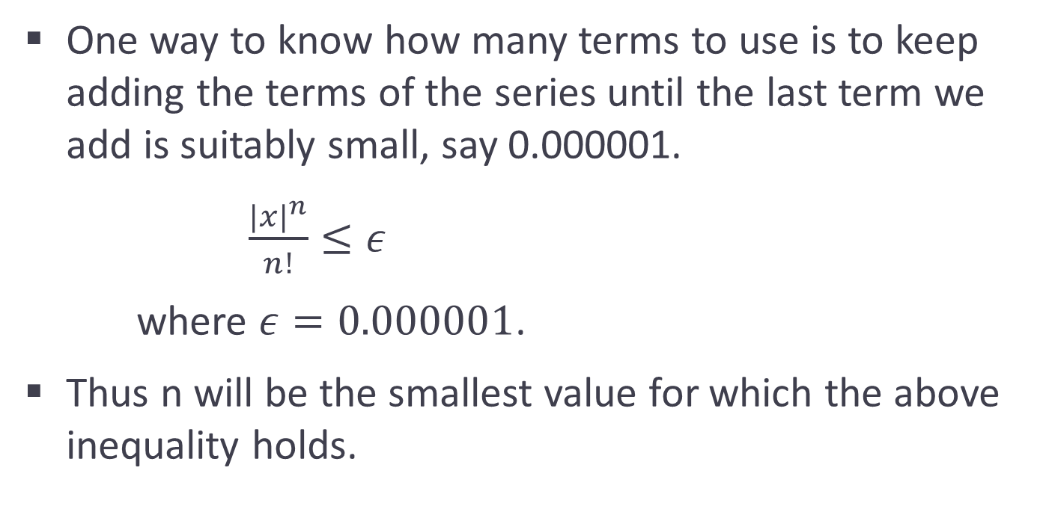
Partial Sums continued
One way to know how many terms to use is to keep adding the terms of the series until the last term we add is suitably small, say 0.000001.
$\frac{{|x|}^{n}}{n!}≤ε$
where $ε=0.000001$.
Thus n will be the smallest value for which the above inequality holds.

Slide 5
Program to Approximate e^{x}
To write a program to approximate the value of e^{x}, we will need to ask the user for the value of x and the value of epsilon.
Then we need the value of the partial sum we are on – let’s call that E and initialize it to ______.
NextTerm will be the next term that we add to E, if it is not smaller than epsilon.
NextTerm = ???????

Slide 6
Finding the Next Term
Notes:
What should NextTerm be?
To get from 1 to x, multiply by x/1
To get from x to x^2/2, multiply by x/2
To get from x^2/2 to x^3/6,multiply by x/3
Etc…
So NextTerm = NextTerm *x / n

Slide 7
Checking if NextTerm is too small
Using a while loop we can first check if NextTerm is less than or equal to epsilon before we add it to E.
We must use fabs(NextTerm) though since, depending on the value of x, NextTerm could be negative, and a negative number is ALWAYS less than or equal to a positive epsilon.
If we use fabs, we must include the library header, cmath
#include <cmath>

Slide 8
Complete Program to Approximate e^{x}
#include <iostream>
#include <cmath> // to use fabs
/* The purpose of this program is to approximate e^x by a partial series */
int main()
{
// declare and initialize all variables
double x, epsilon; // will be initialized by user
double E = 1.;
double NextTerm = 1.;
double n = 1.;

Slide 9
count << “Please enter values for x and epsilon: “;
cin >> x >> epsilon;
// echo the values that were inputted
cout << “x = “ << x << “ epsilon = “ << epsilon << endl;
// while loop to approximate E
while (fabs(NextTerm) > epsilon)
{
NextTerm = NextTerm * x / n; // compute the next term
E = E + NextTerm; // update the approximation
cout << “E = “ << E << “ n = “ << n << endl; // output the current approx
n++; // increase n by 1
} // end of while loop
return 0;
} // end of main

Slide 10
Test Run
We need to test our program, so why don’t we use a value of x = 1, so that we get an approximation for e itself.
Also use epsilon = 0.0000001
We should see E = 2.718281828, which is the value of e

